Slide 1
Stable Diffusion
Team 2
Kylah Barlow | Will Hobbs | Ned Ruffin | Rupam Priya

Slide 2
overview
What is Stable Diffusion?
Business Opportunity
What’s Next?
Research
Coding Demonstration
Ethical Concerns

Slide 3
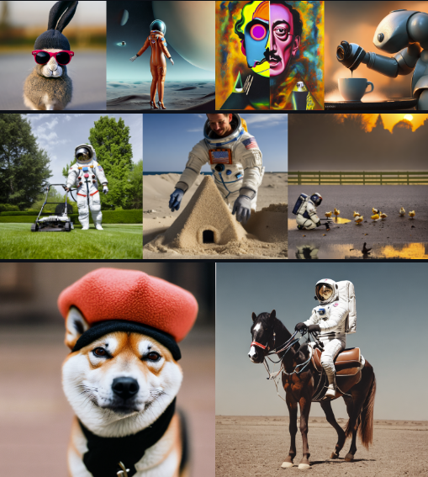
Stable Diffusion 2.1
Released December 27, 2022
Python
General Disclaimer
Patrick Esser & Robin Rombach

Slide 4
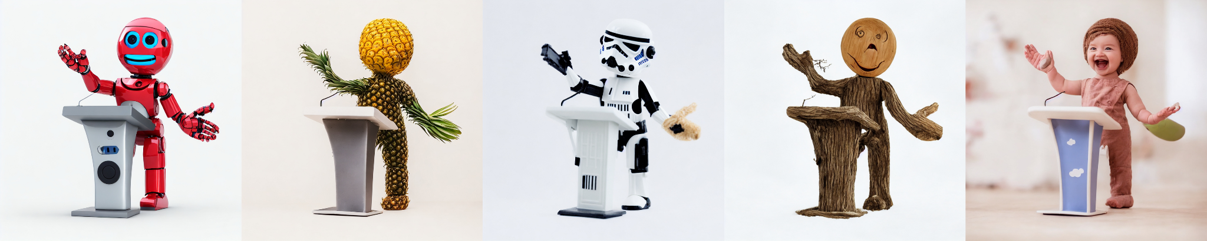
What is Stable Diffusion
High-resolution image synthesis
Text to image
Text to video
Image to image
Image to video

Slide 5
Problem statement
If Stable Diffusion models can accurately produce medically realistic images of observable abnormalities, rare diseases and clinically relevant features.

Slide 6
Peer reviewed article Adapting Pretrained Vision-Language Foundational Models to Medical Imaging Domains
First study to look at latent diffusion modeling for generating medical images.
Chest X-Ray’s (CXR’s) most common imaging modality
Clinical Prompts
Medical Images
Preserving clinical important information
Researchers found the U-Net tuning to be the most effective.
Overall, they found that medical diagnostic features were well preserved when generating realistic medical images.

Slide 7
Peer reviewed article Adapting Pretrained Vision-Language Foundational Models to Medical Imaging Domains
LIMITATIONS
FUTURE DIRECTIONS
Questionable accuracy measures to assess clinical correctness
Low diversity in images generated
Text prompts do not fully correspond with words used in the clinical setting.
Image generation can extend to a wide range of abnormalities.
The ability to combine abnormalities (comorbidity).
Models will be able to generate images for other body parts.

Slide 8
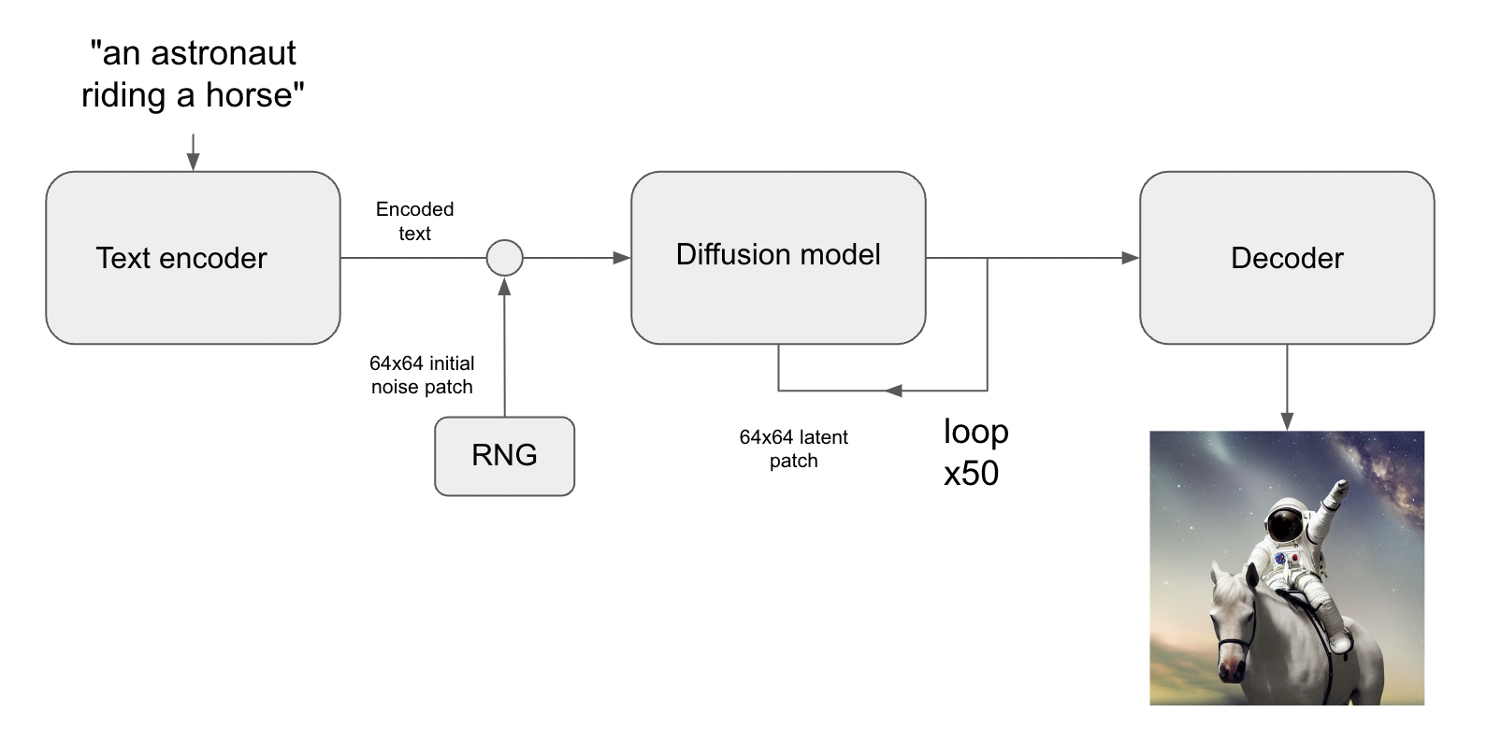
Process

Slide 9
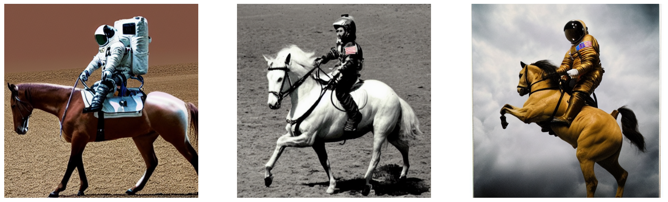
Technical demo

Slide 10
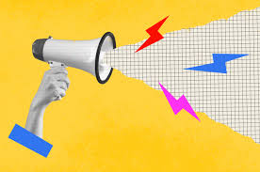
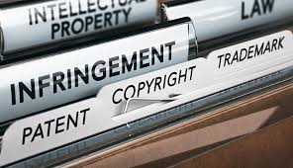
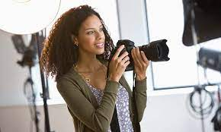
ethical concerns
Copyright / Ownership
Human job loss
Malicious use

Slide 11
What's Next?
Stated Goals
Current Limitations
Improved performance/quality
Optimize for chipsets other than NVIDIA
Reduce adverse outcomes
Perfect photorealism
Legible text
Compositionality
People/Faces
Trained in English

Slide 12
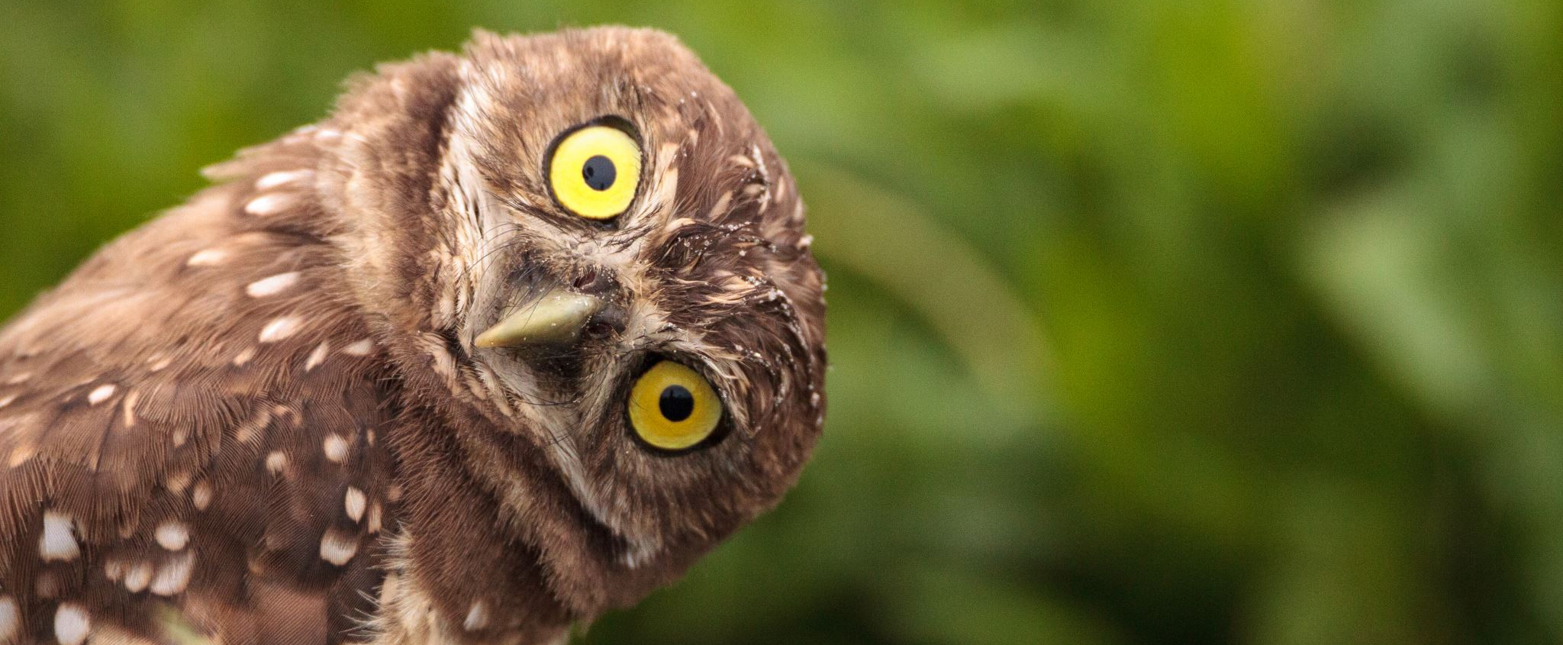
Questions?

Slide 13
Video Demonstration
https://twitter.com/i/status/1557517982095626241

Slide 14
Works Cited
Chambon, P., Bluethgen, C., Langlotz, C. P., & Chaudhari, A. (2022). Adapting pretrained vision-language foundational models to medical imaging domains.
Chollet, F., Wood, L., &amp; Gupta, D. (2022, December 9). High-performance image generation using stable diffusion in KERASCV Tensorflow Core. TensorFlow. Retrieved April 12, 2023.
CompVis. (2022). Stable diffusion online. Stable Diffusion Online. Retrieved April 12, 2023.
Rombach, R., Blattmann, A., Lorenz, D., Esser, P., & Ommer, B. (2022). High-resolution image synthesis with latent diffusion models. In Proceedings of the IEEE/CVF Conference on Computer Vision and Pattern Recognition.
Blattmann, A., Rombach, R., Oktay, K., Müller, J., & Ommer, B. (2022). Retrieval-augmented diffusion models. Advances in Neural Information Processing Systems.

